Slide 1
Elastic Search Overview
Quick Primer

Slide 2
Quick Reality Check
Significant delays when retrieving information from huge databases.
Poor user experience and potential loss of customers.
Retrieval of any meaningful information from across multiple tables is comparatively slow given the nature of RDBMS
Need alternatives where the data is stored in a manner which promotes quick search and retrieval.
This can be achieved by adopting NoSQL database such as Elasticsearch.

Slide 3
What is Elasticsearch?
Elasticsearch is a document-oriented NoSQL database which stores data in JSON format.
It is an enterprise-grade, near real-time search engine based on Lucene.
It is broadly distributable, readily scalable and highly flexible by design.

Slide 4
Advantages of Elasticsearch
Performance
Scalability
Data Record
Query Fine Tuning
RESTful API
Distributed Approach

Slide 5
Advantages of Elasticsearch Elaborated
Performance - It can execute complex real-world queries really fast. Results from structured queries are cached which speeds up common searches.
Scalability - It is a distributed system by nature and hence can easily scale horizontally. It has ability to extend resources and balance load between nodes in a cluster.
Data record - Elasticsearch records any changes made in transactions logs on multiple nodes in the cluster to minimize the chance of data loss.

Slide 6
Advantages of Elasticsearch Elaborated
Query fine tuning - Elasticsearch has a powerful JSON-based DSL, which allows development teams to construct complex queries and fine tune them to receive the most precise results from a search.
RESTful API - Elasticsearch is API-driven, so actions can be performed using a simple RESTful API. It follows the familiar HTTP verbs GET, POST, PUT, DELETE for its CRUD operations.
Distributed approach - Indices in the elastic search node are divided into shards which can be replicated over the cluster. Data added on one node is routed and rebalanced automatically. As the number of nodes in the cluster grow/reduce as per requirement, the data is moved internally with appropriate shard replicas while being transparent to the user the entire time.

Slide 7
Basic Concepts in Elasticsearch
Index - A collection of documents having similar characteristics. Eg Customer Data or Product Catalog. It is identified by unique name that refers to the index while performing search, update and delete operations. Analogous to a database schema in RDBMS
Shards - A shard is a subset of documents of an index. An index can be divided into many shards.
Node - A single server or instance of elastic search that holds data and participates in a clusters indexing and querying. A node can be specified to join certain cluster by particular cluster name. Several nodes can together form a cluster.

Slide 8
Basic Concepts in Elasticsearch
Cluster - A collection of one or more Nodes that hold entire data and gives indexing and search capabilities across all servers.
Near Real Time - Almost real time search platform, having slight delay from the time a document is indexed until it is searchable.

Slide 9
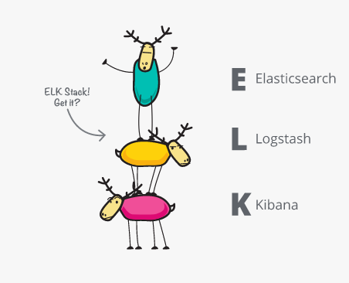
ELK
And it grew with Logstash and Kibana
A search engine at heart, users started using Elasticsearch for logs and wanted to easily ingest and visualize them. Enter Logstash, the powerful ingest pipeline, and Kibana, the flexible visualization tool.

Slide 10
LOGSTASH : Centralize, Transform & Stash Your Data
Logstash is an open source, server-side data processing pipeline that ingests data from a multitude of sources simultaneously, transforms it, and then sends it to your favorite “stash.” (Ours is Elasticsearch, naturally.)
Filters
  Parse & Transform Your Data On the Fly
  Decipher geo coordinates from IP addresses

Slide 11
KIBANA
Kibana is an open source analytics and visualization platform designed to work with Elasticsearch. You use Kibana to search, view, and interact with data stored in Elasticsearch indices. You can easily perform advanced data analysis and visualize your data in a variety of charts, tables, and maps.
Kibana makes it easy to understand large volumes of data. Its simple, browser-based interface enables you to quickly create and share dynamic dashboards that display changes to Elasticsearch queries in real time

Slide 12
Some operations using KIBANA
Filter the data
Query the data
Discover the data
Edit a visualization
Inspect the data behind the scenes

Slide 13
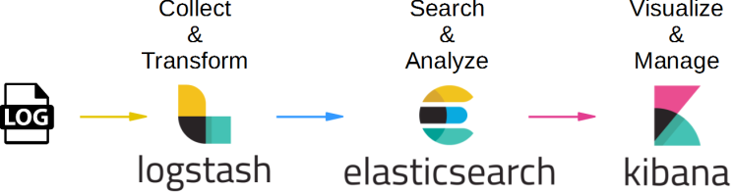
Sample Use case

Slide 14

Thank you
Kaustubh Pandharipande
Sumit Chauhan

